Slide 1
WEB TECHNOLOGIES
BY SHAILESH KUMAR KHANCHANDANI

Slide 2
Topics Covered
Finding computers on Internet – Static vs Dynamic IPs: Introduction to DHCP. Domain Names – DNS Protocol, Nameservers, Zone files and Records, TLDs, Lookups & Reverse Lookups.
Overview of DNS vulnerabilities.
Introduction to WWW, IETF, ICANN and WHOIS.
Introduction to WWW and HTTP: Versions, Headers & Status Codes.

Slide 3
Finding Computers on the Internet: Static vs. Dynamic IPs
Imagine the internet as a giant apartment building. Each apartment has a unique identifier – an address – that allows you to find the people living there. Similarly, every computer connected to the internet has an IP address, a numerical label that helps route information to the right device.
But there's a twist: there are two main types of IP addresses – static and dynamic. Understanding the difference is crucial for finding specific computers on the internet.

Slide 4
Static IPs: Fixed Like Your Home Address
A static IP address is like a permanent apartment number. It remains constant for a particular device, regardless of how often it connects or disconnects from the internet.
This makes static IPs ideal for servers or devices that need to be easily accessible all the time. For example, a company website might have a static IP so users can always find it.
However, static IPs are usually not assigned to home users by default. They often require a specific request or additional fee from your internet service provider (ISP).

Slide 5
Dynamic IPs: Changing Like Renting an Apartment
Most home users have dynamic IP addresses. These addresses are assigned by the ISP each time a device connects to the internet.
They're like renting an apartment – the number changes periodically. This helps conserve IP addresses as many devices only connect occasionally.
Finding a computer with a dynamic IP can be challenging because its address keeps changing.

Slide 6
Introduction to DHCP
Imagine a college dorm with hundreds of students. Assigning each student a room key every day would be irritable ! Thankfully, dorms have a central system to manage keys. The internet has a similar system for IP addresses, and it's called DHCP (Dynamic Host Configuration Protocol).
What is DHCP?
DHCP is a network protocol that automatically assigns IP addresses to devices on a network.

Slide 7
Here's how DHCP works:
Device Seeks an Address: When a device (like your laptop) joins a network, it broadcasts a message saying, "Hey, I need an IP address!"
DHCP Server Responds: A DHCP server on the network hears the request and offers a free IP address from a pool it manages.
Device Accepts: The device accepts the offered IP address and uses it to communicate with other devices on the network.
Lease Agreement: The IP address isn't permanent, though. It's leased for a specific time (called a lease period). Before the lease expires, the device can renew it with the DHCP server.

Slide 8
Benefits of DHCP:
Reduced Manual Work: DHCP eliminates the need to manually configure IP addresses for every device on a network. This saves network administrators a lot of time and effort.
Efficient IP Address Management: DHCP ensures that IP addresses are used efficiently. When a device disconnects or its lease expires, the address is released back to the pool for another device to use.
Reduced Errors: Manual configuration is prone to typos, leading to network connectivity issues. DHCP eliminates this risk by automating the process.
Overall, DHCP plays a crucial role in keeping our networks running smoothly and efficiently. It ensures every device has the information it needs to talk to each other, just like having the right key allows you to access your dorm room.

Slide 9
Web's Address Book: Domain Names, DNS, and More
Imagine if every website had a long, complex string of numbers as its address – like visiting "172.217.160.137" instead of "[invalid URL removed]." Thankfully, the internet uses a much friendlier system: domain names. But behind the scenes, a complex yet fascinating protocol called DNS (Domain Name System) translates these user-friendly names into the numerical language computers understand (IP addresses).

Slide 10
Here's a breakdown of the key players involved:
Domain Names: These are the easy-to-remember addresses you type into your web browser, like "facebook.com" or "wikipedia.org".
DNS (Domain Name System): Think of DNS as the internet's phonebook. It maps domain names to their corresponding IP addresses. When you enter a domain name in your browser, DNS translates it into the IP address the computer needs to connect to the website.
Nameservers: These are specialized servers that store and manage DNS records. They act like the individual entries in a phonebook, containing the domain name and its corresponding IP address.

Slide 11
Zone Files: These are electronic files stored on nameservers. Zone files essentially contain the "data" for a specific domain, like its name, IP address, and other settings.
DNS Records: Within zone files, DNS records are specific details about a domain. Common record types include:
A Record: Maps a domain name to an IP address (like the phone number in a phonebook entry).
MX Record: Specifies the mail server responsible for receiving emails for that domain.
CNAME Record: Used to create an alias for another domain name.
TLDs (Top-Level Domains): These are the suffixes at the end of a domain name, like ".com", ".org", or ".net". They categorize the type of website or organization the domain belongs to.

Slide 12
How it Works (DNS Lookup):
You Enter a Domain Name: When you type a domain name in your browser, it doesn't directly connect to that address.
Browser Queries the DNS Resolver: Your browser acts like a personal assistant, contacting a DNS resolver (often provided by your internet service provider)
Resolver Queries Nameservers: The resolver then queries nameservers to find the IP address for the domain name. There might be multiple levels of queries involved depending on the domain's configuration.
Nameserver Responds: The appropriate nameserver responds with the IP address for the domain name.
Browser Connects to Website: Finally, your browser receives the IP address and uses it to connect to the website.

Slide 13
Reverse DNS Lookup
While DNS lookups translate domain names to IP addresses, reverse DNS lookups do the opposite. They're used for security purposes or troubleshooting, where an IP address is used to find the associated domain name.

Slide 14
Overview of DNS vulnerabilities
DNS, the Domain Name System, is essential for the internet to function. It translates human-readable website names into numerical IP addresses that computers can understand. Unfortunately, this system has some inherent vulnerabilities that attackers can exploit. Here's a quick overview of these weaknesses:
Inherent Lack of Security: The DNS system itself wasn't designed with security as a top priority. This makes it susceptible to various attacks.
DNS Spoofing and Cache Poisoning: Attackers can intercept or manipulate DNS requests to redirect users to malicious websites. This can be done through techniques like DNS spoofing, where a fake DNS server impersonates a legitimate one, or DNS cache poisoning where a hacker tampers with a DNS server's cache to provide false information.
Other Attack Types: DNS vulnerabilities can be exploited for various attacks besides spoofing. Attackers can use DNS for data exfiltration through techniques like DNS tunneling or overwhelm DNS servers with traffic in a DoS (Denial-of-Service) attack.

Slide 15
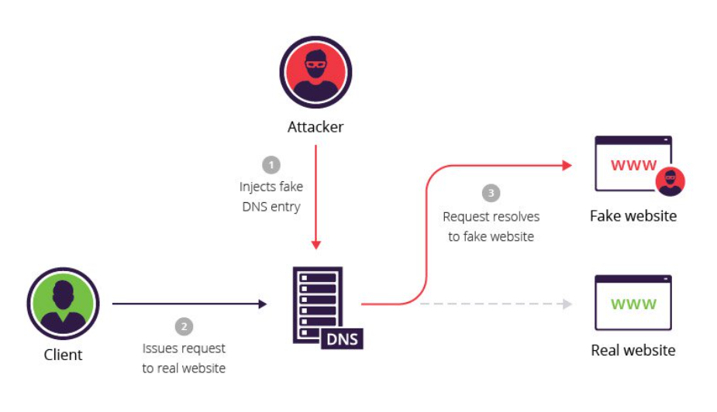
These vulnerabilities can have serious consequences. Users can be tricked into visiting fake websites designed to steal personal information or infect their devices with malware. Additionally, DNS attacks can disrupt critical services by making legitimate websites unavailable.

Slide 16
World Wide Web (WWW)
The World Wide Web is the most commonly used part of the internet. It's what allows us to access websites and navigate through hyperlinks. The Web utilizes the concept of URLs (Uniform Resource Locators) to address webpages and uses the HTTP (Hypertext Transfer Protocol) to communicate between web servers and browsers.

Slide 17
Internet Engineering Task Force (IETF)
The IETF is a global community of engineers, network designers, and other technical experts who develop the standards and protocols that make the internet work. They are essentially the behind-the-scenes crew defining how data is formatted and transmitted across the internet. The IETF is a volunteer-based organization that ensures the internet remains interoperable and functions seamlessly.

Slide 18
Internet Corporation for Assigned Names and Numbers (ICANN)
ICANN is a non-profit organization responsible for managing the Domain Name System (DNS). They are in charge of assigning unique domain names and IP addresses to avoid conflicts. ICANN also plays a role in introducing new top-level domains (TLDs) like the recently introduced ".app" or ".blog"

Slide 19
WHOIS
WHOIS is a service that allows you to query a database and find out who owns a specific domain name. This information typically includes the registrant's name, organization, email address, and creation date of the domain. It's important to note that WHOIS privacy protection services can mask some of this registrant information.

Slide 20
Introduction to WWW and HTTP: Versions, Headers & Status Codes
The World Wide Web (WWW) and Hypertext Transfer Protocol (HTTP) are the cornerstones of our web browsing experience.
The WWW is the user-facing part of the internet, allowing us to access websites through hyperlinks. Imagine it as a vast library with interconnected documents. Here's how it works:
URLs (Uniform Resource Locators): These act like addresses for webpages. They specify the location and protocol (like HTTP) used to access the webpage. An example URL is "https://www.google.com/".
Hyperlinks: These are embedded links within webpages that, when clicked, take you to another webpage. They are the foundation of the web's interconnected nature.

Slide 21
HTTP is the communication language between web browsers and servers. It dictates how data is exchanged to display webpages on your screen. Here's a breakdown of its key aspects:
Versions:
HTTP has evolved over time. Common versions include:
HTTP/1.0: The initial version with limited features.
HTTP/1.1: The most widely used version, supporting features like persistent connections and pipelining to improve efficiency.
HTTP/2: A more recent version that utilizes multiplexing to send and receive data concurrently for faster loading.
Headers:
These are additional lines of information attached to HTTP requests and responses. They provide context for the data being transferred. Here's an example header:

Slide 22
Status Codes:
These are numerical codes sent by the server in response to a client's request. They indicate the success or failure of the request. Common status codes include:
200 OK: The request was successful.
404 Not Found: The requested resource could not be found.
500 Internal Server Error: An error occurred on the server side.
The WWW provides the user interface for navigating websites, while HTTP acts as the underlying communication protocol that makes it all work. Understanding these concepts helps us appreciate the intricate mechanisms behind our everyday web browsing experience.

